Slide 1

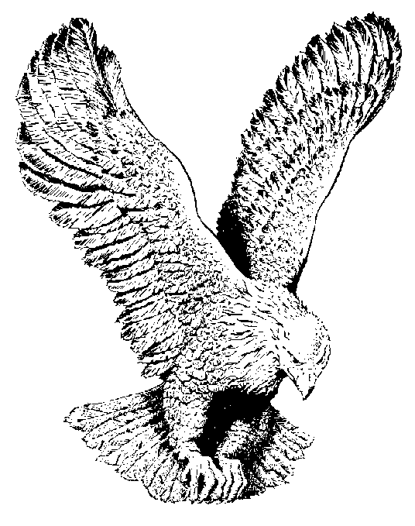
AKA AKA YA
Aka aka ya
Aka Jehovah na’eme mma
Olu ebube ya
Nke na eruari na’ ebem no
Isi iyi nke ndu
Nke na dighi ata’ta
Aka aka ya
Aka Jehovah na’eme mma

